Slide 1
Heuristic Evaluation
Underline. Place for the Art.

Slide 2
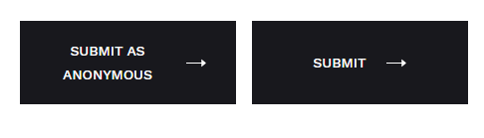
Strive for consistency
Familiar icons, colors and menu hierarchy have been designed to describe similar situations and the way information is conveyed has been standardised to let users apply their knowledge from one click to to the other.
Usage of the familiar Cart Icon
Home button that leads to the home page

Slide 3

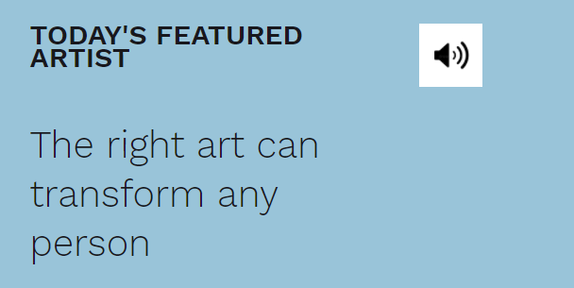
2. Enable frequent users to use shortcuts
Increased usage of a few buttons and menu options which are in a higher demand have been placed such that the User can quickly access these buttons or categories. This can help the user operate the user interface more quickly and effortlessly.
Usage of ‘Favourites’ in the Category of Arts
Inclusion of a shortcut for the audio button

Slide 4


3. Offer informative feedback
The User Interface has been designed in such a way that the user would know where they are at and what is going on at all times. Appropriate, human readable feedback has been included wherever necessary to make the user activity better and meaningful.
Status changes from “Add to cart” changes to “Adding to Cart” to enable appropriate, human readable feedback while buying art
“View Product” status when the user hovers over each product.

Slide 5
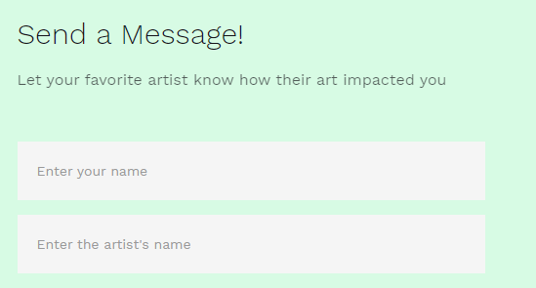
4. Design dialogs to yield closure
The designed User Interface lets the user know what their action has led to and discards any ambiguity that might pop up while making purchases or any other crucial activity.
A “Thank You” message displayed when the artist uploads the Art on our website.
Changes the status of the product to “Purchased” when the user finishes their purchase.

Slide 6
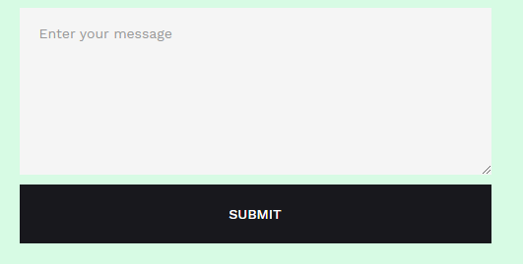
5. Offer error prevention and simple error handling
The User Interface has been designed to be as fool-proof as possible. Whenever unavoidable errors occur in the website due to human activity, users are provided with simple, intuitive step-by-step instructions to solve the problem as quickly and painlessly as possible.
Empty Input text fields are highlighted
Disabling the checkout option if no product is present in the Cart

Slide 7

6. Permit easy reversal of actions
The User Interface offers obvious ways of reversing actions performed by the user. These reversals have been permitted at various points whether it occurs after a single action or a whole sequence of actions.
Easy removal of product from the cart once added
Easy backward navigation through the navbar

Slide 8
7. Support internal locus of control
Our User Interface allows users to be the initiators of actions. It gives users the sense that they are in full control of events occurring in the digital space.
The Navigation bar gives complete control to the user for navigation
User can navigate throughout the website using the footer as well.

Slide 9

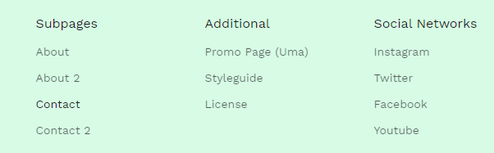
8. Reduce short-term memory load
The User Interfaces has been designed to be as simple as possible with proper information hierarchy, and choosing recognition over recall.We have provided the option of choosing options from the given ones wherever possible to reduce the memory load on the user
Display of all the categories of art on the ‘Arts Collection’ Page
Presence of Footer with all the page options

Slide 10
Thank You.

